Slide 1

Community Health Advanced by Medical Practice Superstars
(CHAMPS)

Slide 2
Purpose
To train, develop, and support primary care champions who will be equipped and empowered to lead health care transformation in underserved and rural settings in the Southeastern United States.

Slide 3
Who is it for?
The Department of Family Medicine at Morehouse School of Medicine (MSM) is seeking physicians and physician assistants (PA’s) in the Southeastern US that serve patients in the following areas:
  Medically underserved metropolitan areas
  Federally Qualified Health Centers (FQHC’s)
  Healthcare Physician Shortage areas (HPSAs) in rural communities.

Slide 4
Objectives
Develop leadership capacity in healthcare transformation for primary care professionals
Increase integrated and coordinated care services within and between care settings
Improve the quality of care in healthcare organizations
Increase patient access to care
Advocate for health equity for the populations they serve

Slide 5




Morehouse School of Medicine Partners
Department of Family Medicine
Satcher Health Leadership Institute
Kennedy Satcher Center for Mental Health Equity Integrated Care Leadership Program (ICLP)
National Center for Primary Care (NCPC)
Institute for Healthcare Improvement (IHI)

Slide 6
Overview of Activities
CHAMPS fellowship is a 12-month training program and eligible hours of CME.
Monthly meetings with CHAMPS faculty at one’s practice
Monthly virtual coaching sessions with subject matter experts
In-person meetings in Atlanta for hands-on training in leadership, healthcare transformation, and advocacy

Slide 7
Benefits of the Program
A stipend and Surface Pro will be provided to supplement participants’ time and resources
Participants will be fully supported in developing and implementing a healthcare transformation project to improve their practice
Learning modules are completed online and tailored for the busy physician or physician assistant
As a HRSA-funded project, participation can be applied to any NHSC obligations they may have.

Slide 8
Key Instructional Components
On-line courses via Canvas in Leadership, Integrated Health, Quality Improvement and Healthcare Transformation
Monthly Reports highlighting practice successes, challenges, and leadership activities
Development of a Healthcare Transformation Project
Development of Abstracts for presentation and publication
Mentorship with CHAMPS Fellows and MSM Faculty

Slide 9
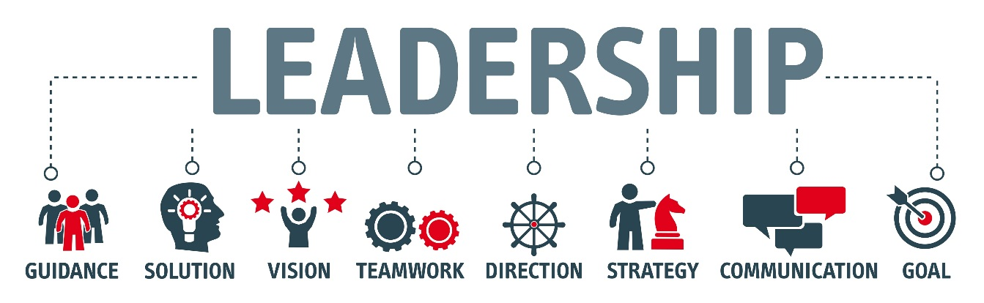
Transformative Leadership in Integrated Practice
The interactive online learning curriculum is comprised of three modules:
Transformative Leadership
Clinical Practice Skills
Sustainability.

Slide 10
Healthcare Transformation Projects
Fellows will select transformation projects that address critical needs for their health care institution
Learn how to conduct a needs assessment and develop a plan for projects.
Learn the principles of data science and evaluation
Implement projects related to the HHS Clinical Priorities.
  mental health, opioid abuse and childhood obesity.
Supported to present at conferences and submit for publication

Slide 11
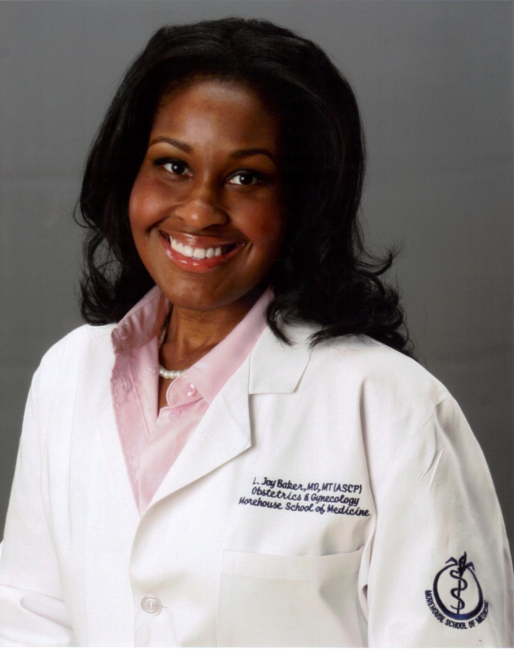
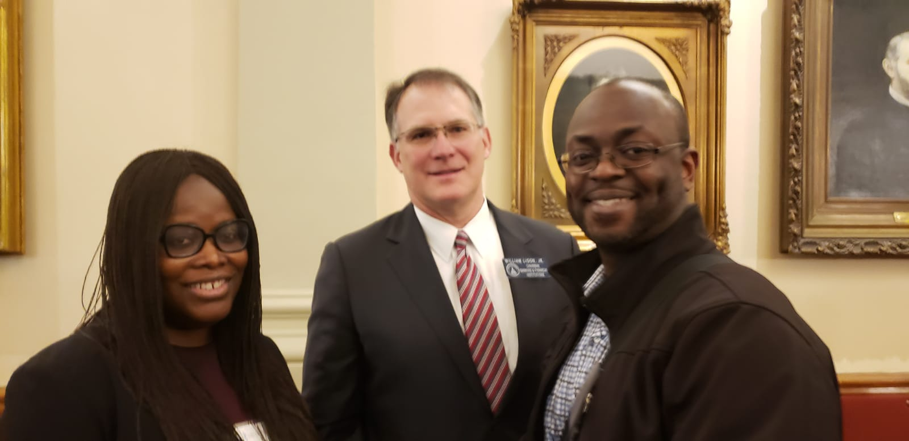
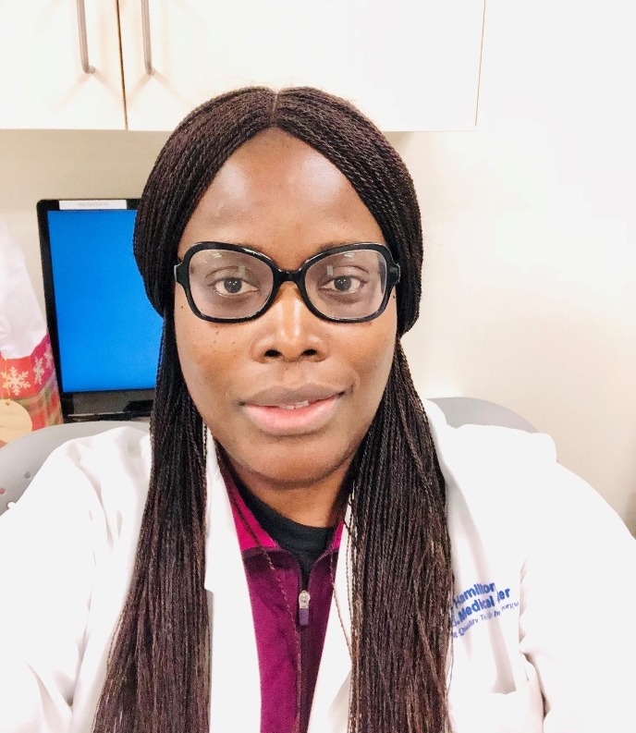

Slide 12
Additional Information
To learn more about the CHAMPS program at Morehouse School of Medicine, please contact us at MSMCHAMPS@msm.edu
To apply, visit https://www.msm.edu/Education/champs/index.php

Slide 13


